Slide 1
SWEN90016 Software Processes & Project Management
SDLC Process
Agile Project Management
2019 – Semester 2
Tutorial 3
Copyright University of Melbourne 2017

Slide 2
Today’s aim
Create Teams for Assignment 2
- Make sure your tutor knows!

Slide 3
Today’s aim
Explore Agile
Project Management
& SDLC
Create Teams

Slide 4
PM – Phase Overview
Formal (Waterfall) PM Stages:
Initiation
Plan
Execute
Monitor & Control
Close
Agile Scrum PM Stages:
Initiation
Sprint Plan
Sprint
Adapt: Review & Retrospective
Release

Slide 5
Trello
Consider Trello tool to implement Visual Board.
https://trello.com/b/pXMSk97J/welcome-board

Slide 6
Quiz
Quiz Questions
Discuss in groups the following 16 questions
Record your answers in the sheet.
The share your answers with the class

Slide 7
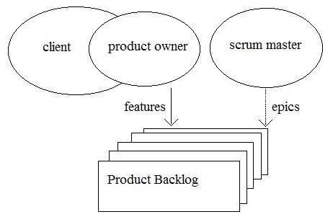
Agile PM – Sprint Plan
1.
Who is responsible for identifying the product’s features?
Product Owner
In a small start-up, the client and Product Owner may be the same person.
In a large corporation, the client may be a VIP and not give time to the project but delegate responsibility to the Product Owner.

Slide 8
Agile PM – Sprint Plan
2.
Where does Scrum express the produce’s scope?
Product Backlog
The scope is expressed as a list of features in the Product Backlog

Slide 9
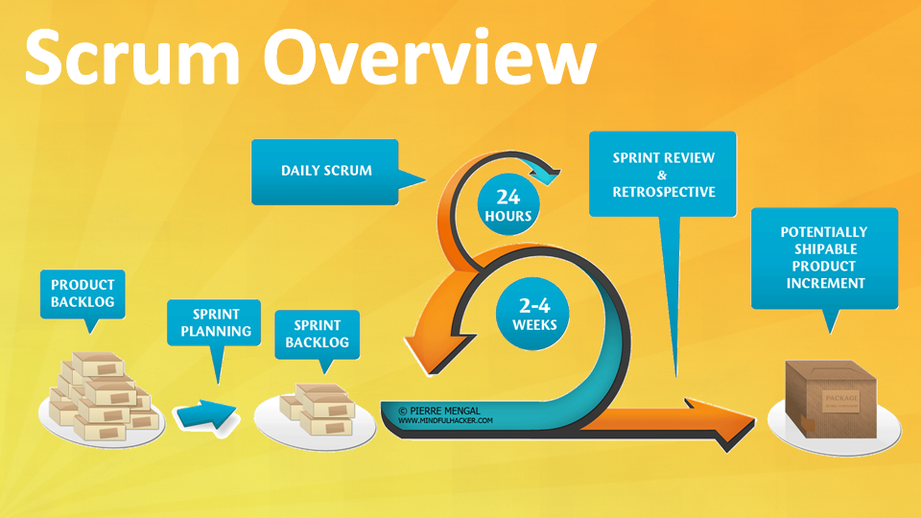
Agile Software Development Life Cycle
The Product Backlog documents every feature the product:
must have,
should have &
would be nice to have?

Slide 10
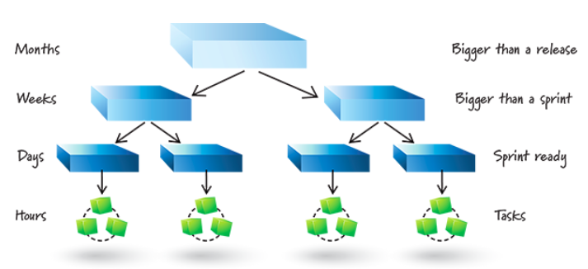
Agile PM – Sprint Plan
3.
How does Scrum express the product features?
each is a User Story
SME/Product Owner has a “Just-In-Time” conversation
with the Developer to add the detailed requirements

Slide 11
Agile PM – Sprint Plan
4.
How does Scrum envisage the cost, the date and what features the product will deliver ?
In the ideal Release Burndown Chart
features
cost & date
Groom User Stories in Product Backlog
Select high business value User Stories into a release
Add quick & cheap Story Point estimation to these User Stories
Use team velocity to estimate when done

Slide 12
Agile PM – Sprint Plan
4.
How does Scrum envisage the cost, the date and what features the product will deliver ?
In the ideal Release Burndown Chart
features
cost & date
Groom User Stories in Product Backlog
Select high business value User Stories into release
Add quick & cheap Story Point estimation to User Stories
Use team velocity to estimate when done
Actual Chart updated after each Sprint by the Scrum Master

Slide 13
Agile PM – Sprint Plan
Product Milestones indicate a significant feature set.
5.
How does Scrum express Product Milestones?
Add Milestones to the Product Backlog
An important code chunk,
useful to external stakeholders

Slide 14
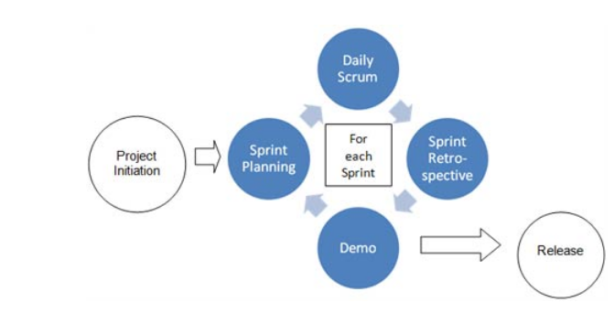
Agile Estimates
1.
Consider these User Stories.
Are these activities epic, feature or low level?
Decompose activities if required.
Add Story Point estimates for each activity.

Slide 15
Agile Estimates
1.
Are these activities epic, feature or low level?
Decompose activities if required.
Add Story Point estimates for each low-level activity.
feature
epic
feature
Notes:
.

Slide 16
Agile Estimates
1.
Budget & Release Date tasks could be considered features, as it is the responsibility of only a few stakeholders. These small User Stories can be reliably estimated.
Project Charter task could be considered an epic, as it involves many more stakeholders than the Product Owner and Scrum Master. The epic with 13 points needs further decomposition before it’s estimation has credibility.

Slide 17
Agile Estimates
2.
Consider these User Stories.
What is the Story Point estimation of the current task?
Who is assigned to the current task
Current task
Who
Estimate: 13 Story Points

Slide 18
Agile Estimates
Developer
has a conversation
with
Product Owner/SME
to decompose
Sprint User Story into Task hours.

Slide 19
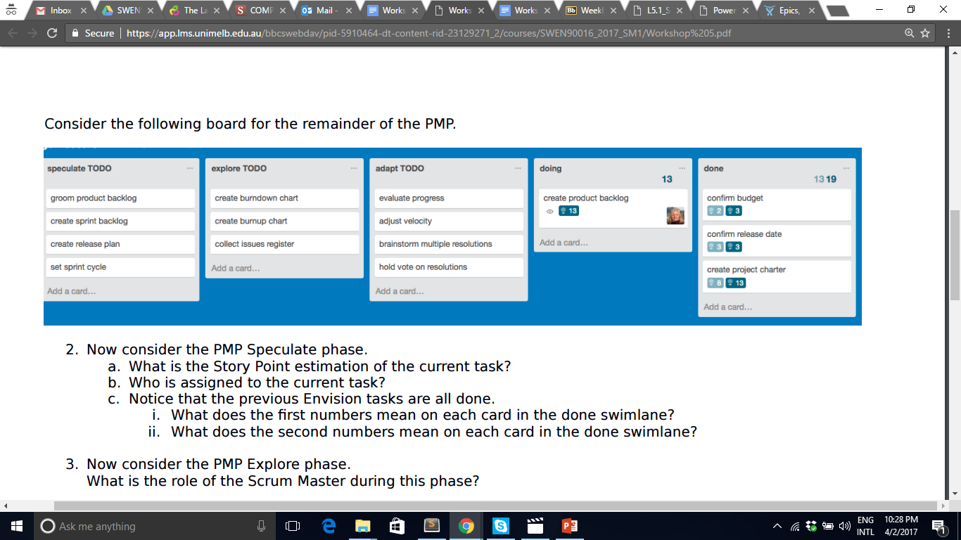
Agile Estimates
3.
Consider these User Stories.
Notice that the previous Initiation tasks are all done.
a) What does the 1st number mean on each card in the done swimlane?
b) What does the 2nd number mean on each card in the done swimlane?
Actual
Story Points
Estimated
Story Points

Slide 20
Agile Team
1.
What is the Scrum Masters primary responsibility?
A servant leader to the developer team
… maybe more of an observer, (a chicken)

Slide 21
Agile SDLC
Agile Software Development Life Cycle
1.
Identify in which phase the software coding happens
The Sprint phase

Slide 22
Agile SDLC
2.
Where would you document the minimum features the product increment must have before it can be released
Sprint Backlog lists the minimum features for a chunk of usable product.

Slide 23
Agile SDLC
3.
In the daily Stand-up meeting:
What THREE questions are answered?
Who talks during the Stand-up meeting?
What I did yesterday
What I plan to do today
What issues are blocking my progress
The development team, which includes the Scrum Master

Slide 24
Agile SDLC
4.
How do you monitor the productivity of the Sprint?
For User Stories in the Sprint Backlog:
Decompose each and re-estimate more carefully
Will this number of Story Points fit in Sprint?
Monitor “done” User Stories on Sprint Burndown chart
Update actual velocity at end of Sprint
Estimate
Actual
Velocity

Slide 25
Agile PM – Adapt
1.
In the Adapt phase, what are the meetings called?
Sprint Retrospective
Sprint Review

Slide 26
Agile PM – Adapt
Inspect and adapt the product
2.
Who is invited to the end of Sprint Review?
Scrum Master
A showcase for a big audience

Slide 27
Agile PM – Adapt
3.
Inspect and adapt the team
Who is invited to the end of Sprint Retrospective?
Scrum Master
Reflection, without management overview
The team includes the Scrum Master
Product Owner is often invited.

Slide 28

Scrum PM - Release
A team event.
Celebrate success!
An emotional time.

Slide 29
Thank You!

